Slide 1
Spring batch

Slide 2
Batch Jobs Challenges
The code that implements the batch job is a mess. Because it has only one huge step, no one cannot really understand how the batch job works.
The batch job is slow because it does everything inside a HUGE transaction.
The batch job doesn't have a real error handling. If an error occurs during a batch job, the job simply fails. However, if you are lucky, the batch job might write an error message to a log file.
The batch job doesn't clean up the output data that's written to the configured output if it fails. This is a problem because you cannot trust the data that's produced by the batch job. In other words, you have to ensure (manually) that the output data of the batch job is correct. This is a waste of time.
The batch job doesn't report its final state. In other words, there is no easy way to figure out if the batch job was finished successfully.

Slide 3
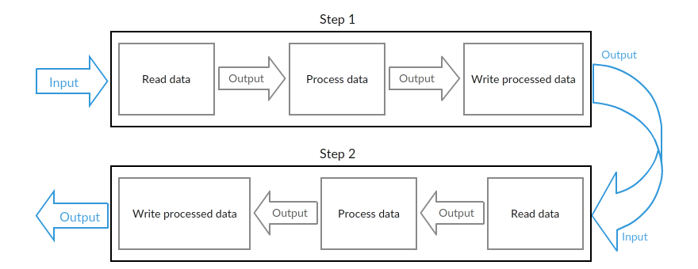
You have to essentially create an in-house batch job framework, and it is extremely hard to get everything right at the first time.
Creating an in-house batch job framework is a big task and it takes time that you don't often have. This means that you cannot fix the problems found from the first version of your batch job framework because you don't have time to do it. That's why all in-house frameworks have their own oddities.

Slide 4
It helps you to structure your code in a clean way by providing the infrastructure that's used to implement, configure, and run batch jobs.
It uses so called chunk oriented processing where items are processed one by one and the transaction is committed when the chunk size is met. In other words, it provides you an easy way to manage the size of your transactions.
It provides proper error handling. For example, you can skip items if an exception is thrown and configure retry logic that's used to determine whether your batch job should retry the failed operation. You can also configure the logic that's used to decide if your transaction should be rolled back.
It writes comprehensive log to the used database. This log contains the metadata of each job and step execution, and it's extremely useful if you have to troubleshoot a failed batch job. Because the log is written to a database, you can access it by using a database client.

Slide 5
A lightweight, comprehensive batch framework designed to enable the development of robust batch applications vital for the daily operations of enterprise systems.
Spring Batch provides reusable functions that are essential in processing large volumes of records, including logging/tracing, transaction management, job processing statistics, job restart, skip, and resource management. It also provides more advanced technical services and features that will enable extremely high-volume and high performance batch jobs through optimization and partitioning techniques. Simple as well as complex, high-volume batch jobs can leverage the framework in a highly scalable manner to process significant volumes of information.

Slide 6
The Key Components of a Spring Batch Job
The Job represents a single Spring Batch job. Each job can have one or more steps.
The Step represents an independent logical task (i.e. import information from an input file). Each step belongs to one job.
The ItemReader reads the input data and provides the found items one by one. An ItemReader belongs to one step and each step must have one ItemReader
.
The ItemProcessor transforms items into a form that's understood by the ItemWriter one item at a time. An ItemProcessor belongs to one step and each step can have one ItemProcessor.
The ItemWriter writes an information of an item to the output one item at a time. An ItemWriter belongs to one step and each step must have one ItemWriter

Slide 7
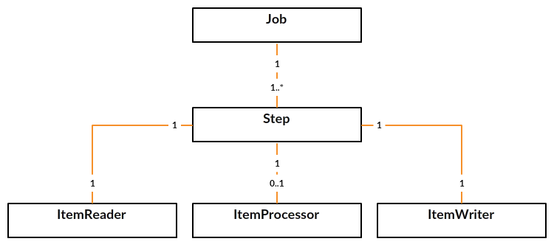

Slide 8
